Slide 1
SCHOOL
BILLING
SYSTEM
SADIA SUBRUN PROMA
ID:181-35-2295

Slide 2
ABOUT MY PROJECT
This project is actually about billing system of school.In this project ,we can add,record,modify,search and delete the records of both account types.It allows us to display fees,dues,total and advance of students and salary-related information of teachers and staffs.For the entry of records,current date,year and month is asked.Then, we can select the account type and perform billing operations like I mentioned above.

Slide 3
OBJECTIVE
General objective :
This study aimed to help a school to have an effective way of monitoring their staff/student salary/fees to give a higher quality of service.
Specific objective:
*Develop a system that will improve the school process in the timekeeping and maintaining accounts.
*Develop a system that will monitor teacher/student date that is efficient to use.
*Secure the records of teacher/student and to have more manageable files,managed by the administrator of the depertment.
*Calculate salary/fee transaction easily
*Summarize all the accounts detail of teacher/student.

Slide 4
FEASIBILITY STUDEY
Before developing this project we need a feasibility study to understand whether the project would be successful or not.
Technology and system feasibility:
The assessment is based on an outline design of system requirements,to determine whether the company has the technical expertise to handle completion of the project.In our case, ‘the peoples university of Bangladesh has an efficient IT department and the personnel from the accounts department has that expertise.
Economic feasibility:
Economic analysis is the most frequently used method for evaluating the effectiveness of a new system.
More commonly known as cost/benefit analysis,the procedure is to determine the benefits and savings that are expected from a candidate system and compare them with cost.if benefits outweigh costs, them the decision is made to design and implement the system.The analysis must accurately weight the cost versus benefits before taking an action.
It is important to identify cost and benefit factors,which can be categorized as follows: 1. Development cost and 2. Operating costs.This is an analysis of the costs to be incurred in the system and the benefits derivable out of the system.

Slide 5
BENEFITES
Interact with the software with menu-driven programs with user friendly interface.
Manage employee information efficiently
Maintain student data efficiently.
Manage the data
Efficiently manage the salary taken by the employees
Prepare the detailed salary record of the employees in an organization

Slide 6
SCOPE & LIITATION
SCOPE
The proposed school billing system will cover many aspects of time keeping and fee/salary process. This includes the capture of information based on the employees work schedule,time worked and daily time rendered. The software process encompasses all activities necessary to report employees time worked.
*The system will have a file management where it covers the records of staff/student
*The system also covers the tracking of salary/fees of staff/student
LIMITATION
The proposed system cannot be accessed online and it focuses only on the school billing system software of the organization.This proposed system is only applicable and can only be used by the management of any school. The proposed system may face data redundancy.

Slide 7
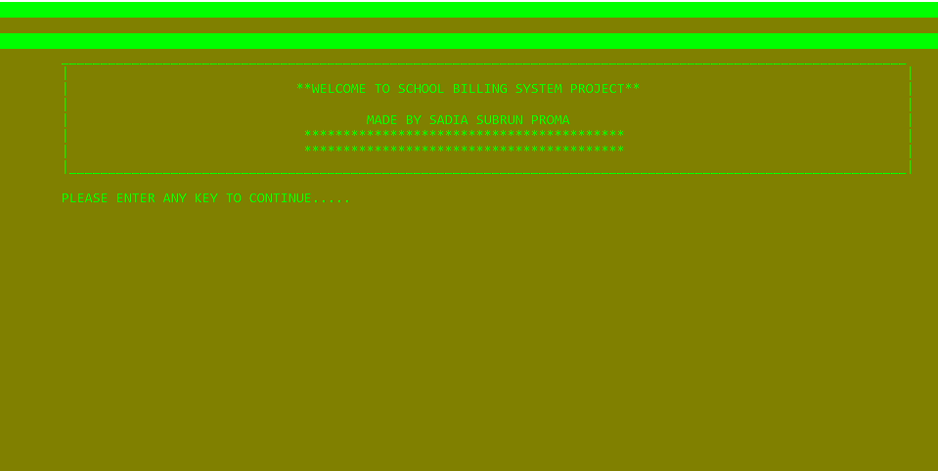
WELCOME SCREEN

Slide 8

DATE MENUE

Slide 9

SELECT ACCOUNT TYPES

Slide 10

PLEASE ENTER YOUR CHOICE FOR STUDENT

Slide 11

PLEASE ENTER YOUR CHOICE FOR TEACHE OR STAFF

Slide 12
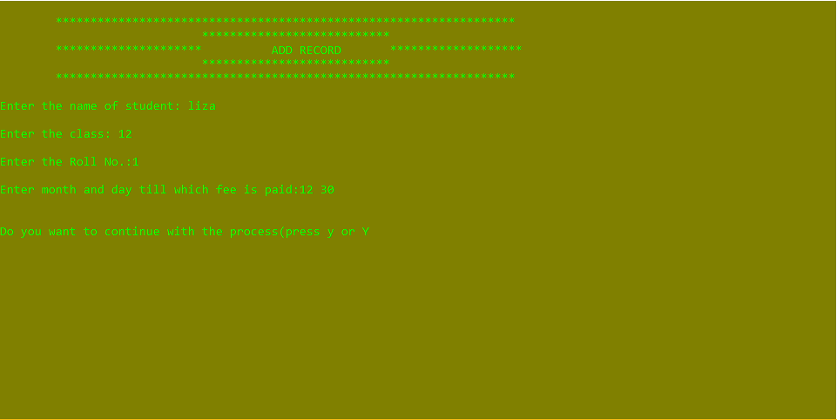
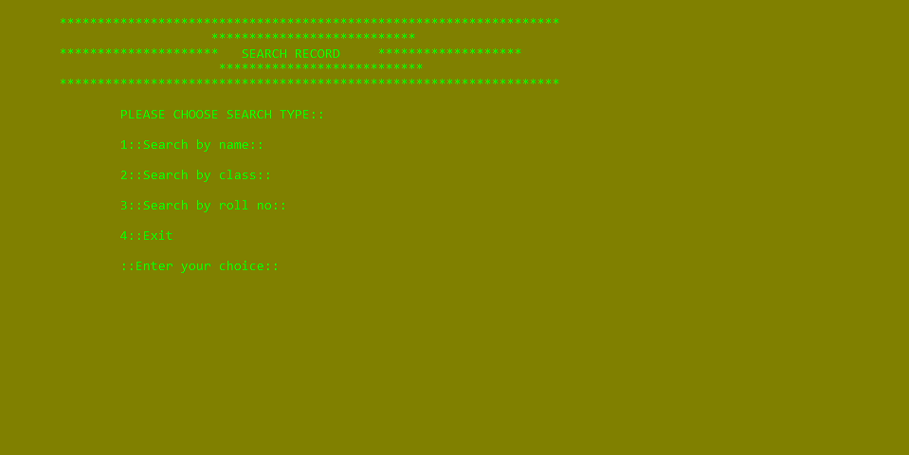
ADD RECORD AND SEARCH RECORD

Slide 13
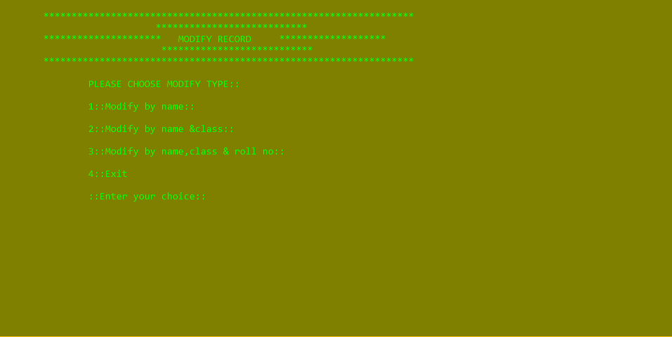

MODIFY RECORD AND DELETE RECORD

Slide 14
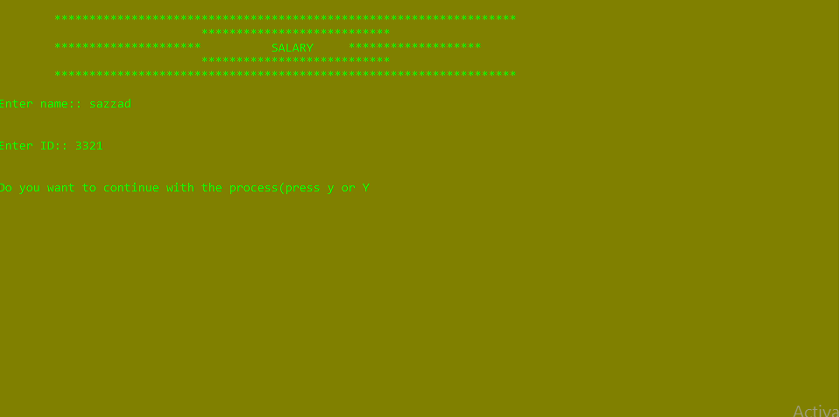
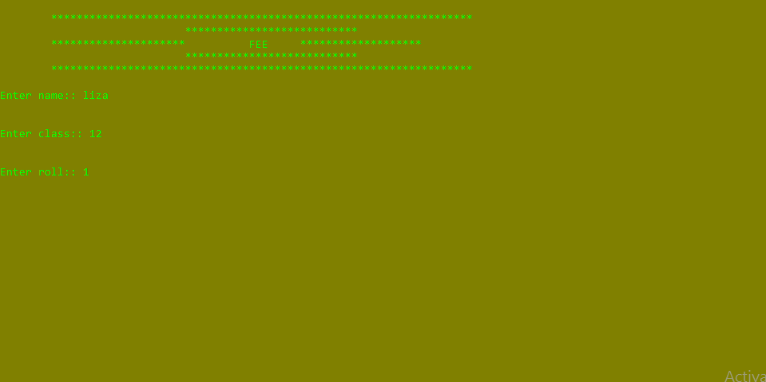
SALARY AND FEE

Slide 15


